Slide 1
Capstone Engagement
Assessment, Analysis, and Hardening of a Vulnerable System
By: Moaaz Niazi

Slide 2
Table of Contents
This document contains the following sections:
01
Network Topology
02
Red Team: Security Assessment
03
Blue Team: Log Analysis and Attack Characterization
Hardening: Proposed Alarms and Mitigation Strategies
04

Slide 3
Network Topology
3

Slide 4
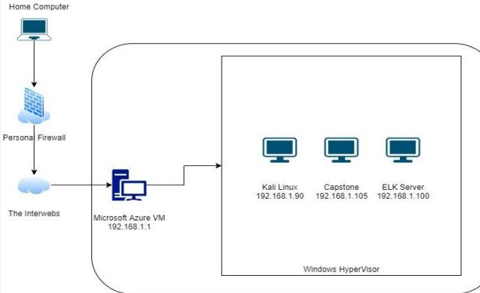
Network Topology
Network
Address Range: 192.168.1.0/24
Netmask: 172.17.196.209
Gateway: 10.0.0.1
Machines
IPv4: 192.168.1.1
OS: Windows XP
Hostname: ML-RefVm-684427
IPv4: 192.168.1.90
OS: Kali
Hostname: Kali Linux
IPv4: 192.168.1.100
OS: Ubuntu
Hostname: ELK Server
IPv4: 192.168.1.105
OS: Ubuntu
Hostname: Capstone

Slide 5

Red Team
Security Assessment
5

Slide 6
Recon: Describing the Target
Nmap identified the following hosts on the network:
Hostname | IP Address | Role on Network
ML-RefVm-684427 | 192.168.1.1 | Microsoft Windows 10 Server
Kali | 192.168.1.90 | Kali Linux VM
ELK | 192.168.1.100 | ELK server VM
Capstone | 192.168.1.105 | Ubuntu Linux VM

Slide 7
Vulnerability Assessment
The assessment uncovered the following critical vulnerabilities in the target:
Vulnerability | Description | Impact
Use the CVE number if it exists. Otherwise, use the common name. | Describe the vulnerability. | Describe what this vulnerability allows the attacker to do.
NMAP port scanning enabled | Ability to scan without limitation or blocks in place allows high level of recon capability | Ability to identify not only ports but type of server and services as well as versions to aid in recon
Hydra Brute force without limitation | Although noisy it is possible to endlessly scan the webserver to gain as many credentials as possible | The impact of being able to brute force a server endlessly is self explanatory; especially if proper alerts are not in play
Easily cracked hashes with weak passwords | Readily available wordlists can crack the weak hashes used by personnel | It only takes one weak password to gain access and allow time to sniff out administrative control

Slide 8
Exploitation: [Recon with NMAP]
01
02
03
Tools & Processes
Detailed NMAP scan of the Capstone virtual machine showed open ports on 22 and 80.
22 did not seem like a viable target so 80 was chosen as there would have been more vulnerabilities to gain access.
Achievements
With the information gathered from allowed scanning we were able to determine type of server and operating system information in order to determine best course of action to attack.
[Nmap –Pn –sC –sV –p- -- open 192.168.1.0/24 –oA lab

Slide 9
Exploitation: [HYDRA – webserver brute force]
01
02
03
Tools & Processes
HYDRA was used to brute force access to admin account as no security measure prevented this action.
Achievements
HYDRA allowed access to webserver secret folder which in turn provided information we can then use to gain additional access to achieve our goal
Hydra –l ashton –P
/usr/share/wordlists/rockyou
.txt 192.168.1.105 http-get
/company_folders/secret_fol
der

Slide 10
Exploitation: [Weak hash easily cracked with John]
01
02
03
Tools & Processes
John was used to crack
simple hash found on
webserver secret folder
Achievements
John provided access to
network share for webserver
where malicious payload was
delivered to exploit the
webserver. This exploit
provided us with a shell to
capture the flag
John --wordlist=
/usr/share/wordlists/rockyou
.txt hash.txt

Slide 11

Blue Team
Log Analysis and Attack Characterization
11

Slide 12

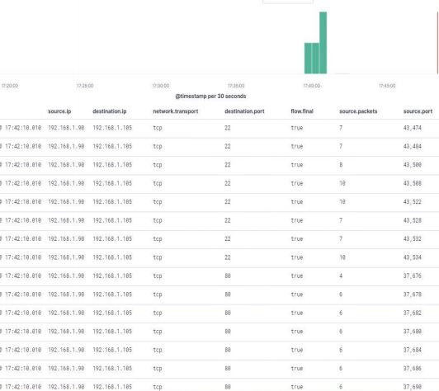
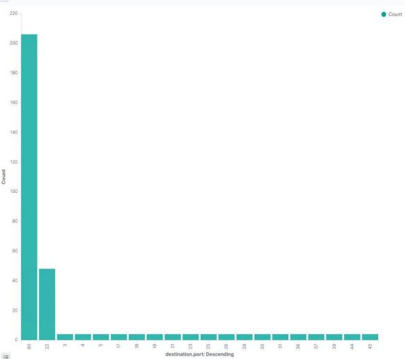
Analysis: Identifying the Port Scan
Port scans took place from 17:39 to 17:41
In this short period there were almost 150k packets exchanged
The graph shows linear packet counts with exception to open ports / ports uncommonly used for web traffic were targeted indicating a scan

Slide 13
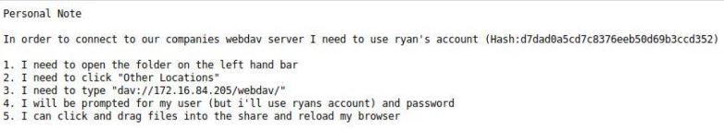
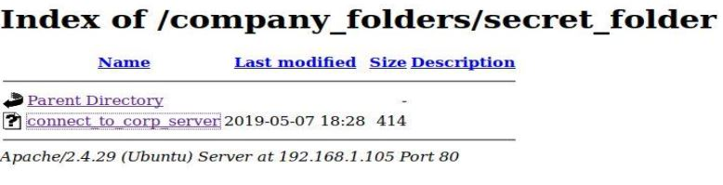
Analysis: Finding the Request for the Hidden Directory
At 00:39 requests were made to access secret folder
Full contents access was requested
● Only 1 file was contained in the folder, but it contained hash information

Slide 14
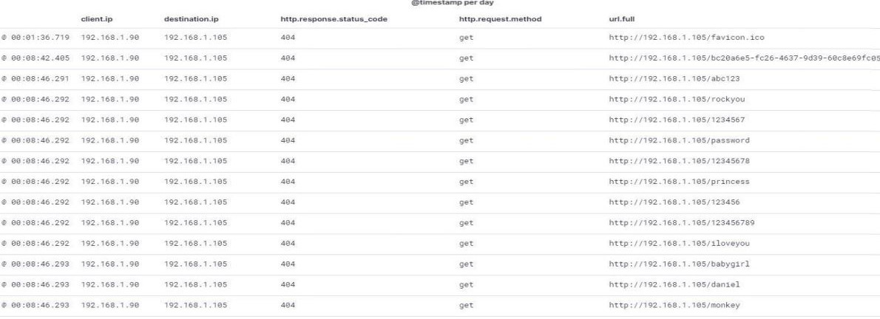
Analysis: Uncovering the Brute Force Attack
2 million attempts were made to brute force the secret folder
The attacker took 1.5 attempts to gain the password indicative of weak password found in common wordlists

Slide 15
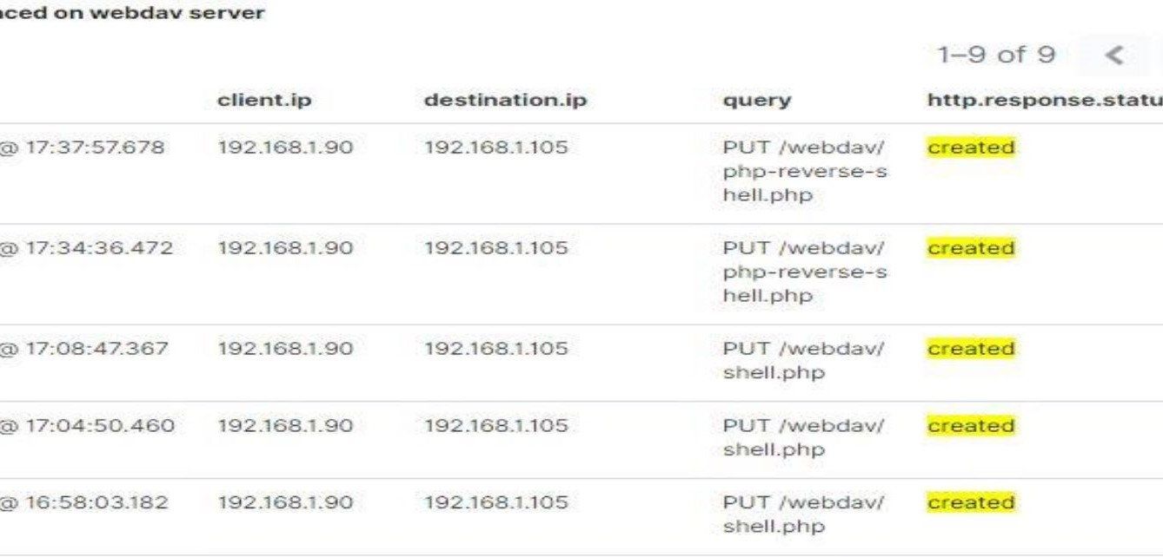
Analysis: Finding the WebDAV Connection
6 requests were made to the WebDAV server as only 1 file existed it was accessed 1 time – also contained a hash
The attacker exfiltrated this file and in turn uploaded a single file entitled shell.php which contained code creating a reverse tcp connection to attacker

Slide 16
Blue Team
Proposed Alarms and Mitigation Strategies
16

Slide 17
Mitigation: Blocking the Port Scan
What kind of alarm can be set to detect future port scans?
Answer: An alert triggered for any request traffic targeting a port other than 80
What threshold would you set to activate this alarm?
Answer: As the ports are closed the threshold would need to be single digit with at least 5 additional ports included as novice attacker likely would check for all ports
What configurations can be set on the host to mitigate port scans?
Answer: Limit server response to requests to be limited to 80 only with drop on any other port
Describe the solution. If possible, provide required command lines.
Answer: Solution would only require configuration of ICMP request blocking on all ports except 80 as required for functionality

Slide 18
Mitigation: Finding the Request for the Hidden Directory
What kind of alarm can be set to detect future unauthorized access?
Answer: Block all remote traffic to specific directories altogether as they do not reduce functionality
What threshold would you set to activate this alarm?
Answer: Upon successful ability to locate directory an alert should be triggered to SOC team for evaluation
What configuration can be set on the host to block unwanted access?
Answer: Again basically blocking remote access to folders and locations not required for functionality
Describe the solution. If possible, provide required command lines.
Answer: Solution requires configuration to remove access remotely and should only be available though specific credential with geolocation validation

Slide 19
Mitigation: Preventing Brute Force Attacks
What kind of alarm can be set to detect future brute force attacks?
Answer: Alert to email SOC team when possible brute force activity is identified
What threshold would you set to activate this alarm?
Answer: Limitation on invalid login attempts set to 5 within 1 minute to trigger alert
What configuration can be set on the host to block brute force attacks?
Answer: Login requirements can be increased to require multifactor authentication which would eliminate brute force ability
Describe the solution. If possible, provide the required command line(s).
Answer: Set mobile device authentication token with 6-digit numerical code set to expire every 60 seconds

Slide 20
Mitigation: Detecting the WebDAV Connection
What kind of alarm can be set to detect future access to this directory?
Answer: Email to SOC manager directly when any activity is detected on WebDAV server as it should only be used by 1 individual
What threshold would you set to activate this alarm?
Answer: Guilty on first offense as the ramifications of unauthorized access with read/write ability is devastating
What configuration can be set on the host to control access?
Answer: This issue is one that bypasses the SOC team and would fall directly on management to isolate and identify
Describe the solution. If possible, provide the required command line(s).
Answer: Set alert and require authorization to write into WebDAV directory; consider multifactor authentication as well

Slide 21
Mitigation: Identifying Reverse Shell Uploads
What kind of alarm can be set to detect future file uploads?
Answer: Simple alert to SOC team anytime directory and folder are modified in any manner
What threshold would you set to activate this alarm?
Answer: Another serious vulnerability concern; therefore, upon detection, alert should be triggered
What configuration can be set on the host to block file uploads?
Answer: Remote access to uploads should be strictly disabled as VPN to internal network is possible to satisfy authorized access
Describe the solution. If possible, provide the required command line.
Answer: Set strict internal network access to file uploads of any kind with zero exceptions

